Slide 1
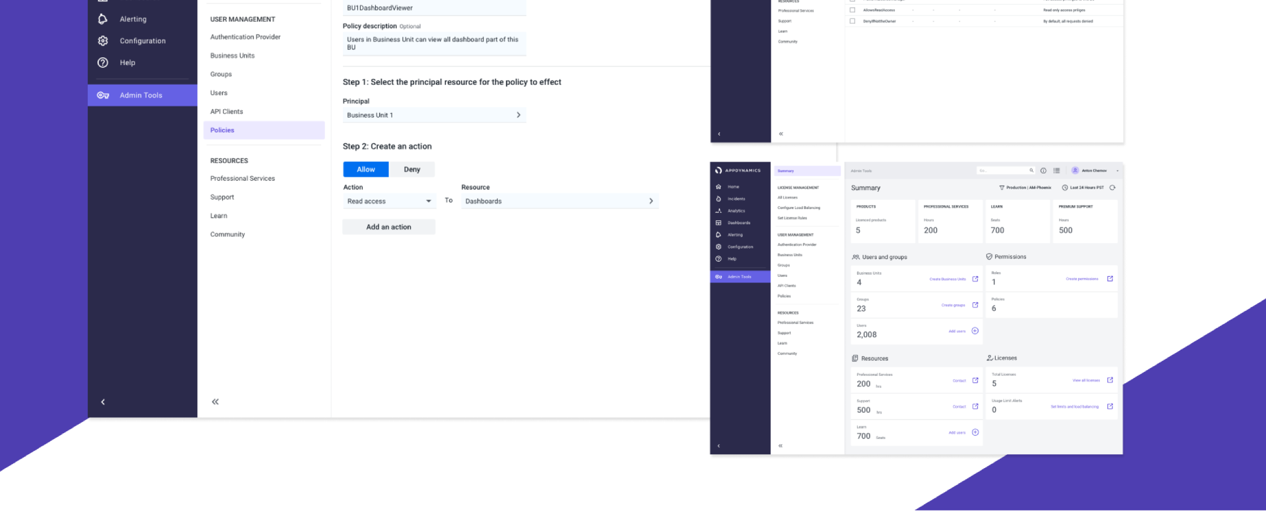
AppDynamics
Access Management
Redefining Access Management for Security and Usability
Notes:
This project reshaped AppDynamics’ access management model, significantly streamlining the process, improving security, and empowering IT administrators to handle permissions effectively across diverse environments.

Slide 2
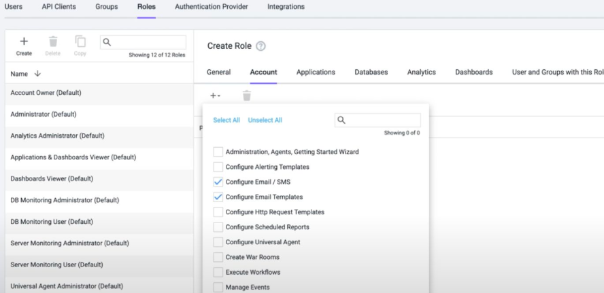
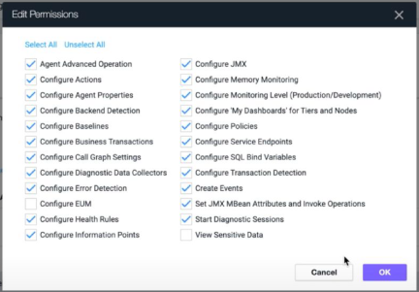
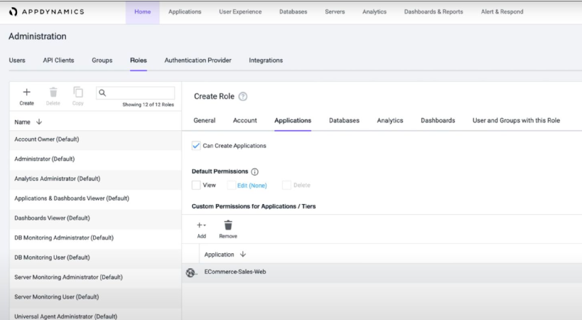
Complex, rigid role-based permissions were creating inefficiency, usability issues and security risks.
Notes:
AppDynamics’ original permissions system was rigid, required excessive manual setup, and created security risks due to limited control options.
Admins had to manually configure permissions across numerous applications and environments, leading to high setup times and frequent errors.
There was no ability to create granular permissions, which made security fragile and inefficient, frustrating users and causing some clients to limit the number of monitored environments.

Slide 3
“
In your product you have to go into 15 different screens, tick the little boxes to say what you want to give them, and then you can’t even find out what’s even [been granted] in one click of a box… …User management is so rubbish.
– System Admin, Banking industry
Notes:
Each role contains a different set of preset permissions.
Every time a user on-boards a new application to monitor, they have to create and assign permissions and access.
Editing these permissions is time consuming, and confusing.
Customers are required to generate up to three roles (View, Application Admin, and Super Admin) for every application.
Customers have 1000+ applications and in some instances requires a dedicated team to manage permissions.
By requiring multiple roles, it’s challenging for Admins who have to retain this knowledge or manage access by trial-and-error
This costs our users time and money

Slide 4


Goals
Enable granular access control, improve security, and reduce role setup time for admins.
Constraints
Needed compatibility with both legacy infrastructure and new cloud-based environments.
Target Users
IT administrators managing multiple environments and user access requirements.
Notes:
At the start of this project we had a role based access control model.
Each role contains a different set of preset permissions.
Every time a user onboards a new application to monitor, they have to create and assign permissions and access.
They have to do this in each hosting environment, that we call “controllers”. Companies have multiple controllers.
Often a permission is presented with an obscure title and a checkbox.
Once created there’s no ability to copy and paste across controller environments.
In other cases multiple roles are required to complete the workflow successfully.
This include frustrations with the system,
high setup times and limited flexibility.

Slide 5
01
02
Design a world where managing permissions was as simple as setting a few clear rules.
Prioritize user satisfaction by reducing setup time strengthening security.
—all by putting business and user needs at the center.
Vision
Notes:
The observability landscape is shifting as many customers are increasingly adopting new technologies, and transforming their businesses in the cloud. The legacy Commercial SaaS AppDynamics product was built on a monolithic infrastructure with outdated technologies.
It has trouble scaling to meet customer needs, and forces users to map their companies onto a rigid App/Tier/Node model that does not necessarily fit their mental model.
As a result our access management and permissions structure is limited, does not scale to users needs, and in some cases exposes security risks.
The scope of this project was to completely redesign the access management experience.

Slide 6

Security with users in mind
Notes:
As the lead designer, I took ownership of redefining access management with a focus on security, usability, and scalability.
Conducting a competitive analysis to benchmark industry standards.
Collaborating with Product and Engineering to align the design with technical feasibility and business goals.
Leading user research to ensure our solution met real-world needs.
Building a scalable design system that could grow with evolving user and business requirements.
Who I partnered with
Engineering leads
Product Managers
UX Research team
Team of 6 designers

Slide 7
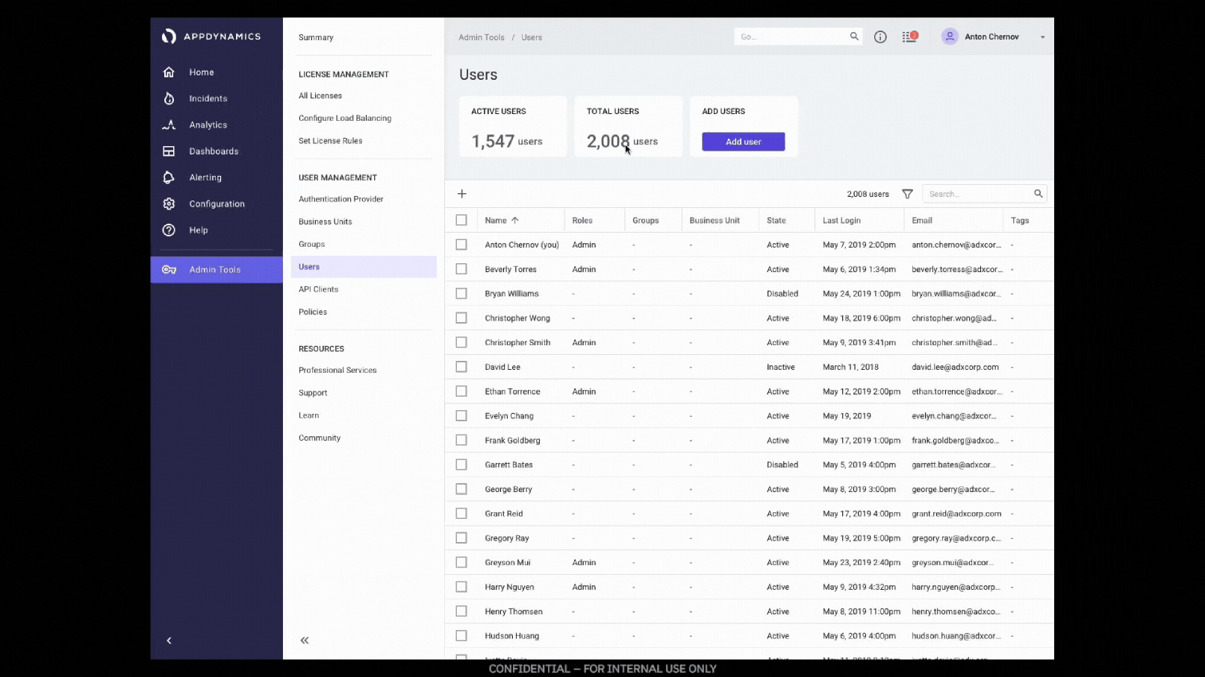

Slide 8




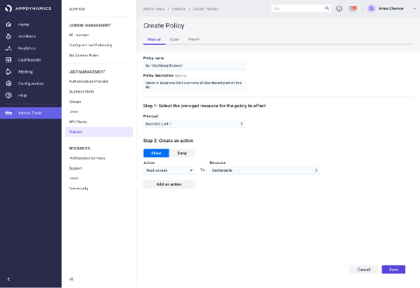
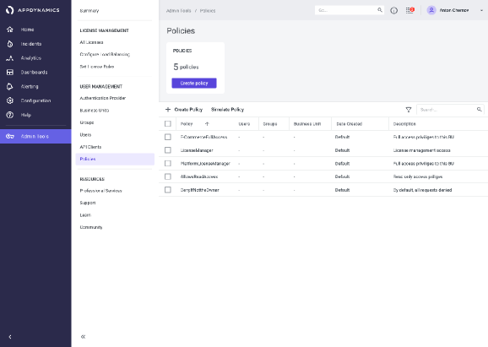
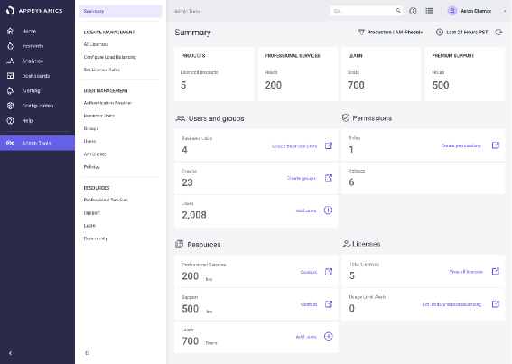
https://www.appdynamics.com
https://www.appdynamics.com
https://www.appdynamics.com
User Goal
Business Goal
Measures
Enable granular access control, improve security, and reduce role setup time for admins.
improving security and usability to retain clients and support scale
Reduce setup time, strengthen security, and improve
user satisfaction
Notes:
Terminology:
IAM: Identity Access Management (industry standard; AWS, google cloud)
Permissions Policy: A Permission policy is an entity that, when attached to an identity or resource, defines their permissions.
Role: A role is a collection of permissions. You cannot assign a permission to the user directly; instead you grant them a role. When you grant a role to a user or group, you grant them all the permissions that the role contains.
Group: A collection of users. You can use groups to simplify specifying and managing permissions for multiple users.
Problem: IT Admins need a way to add other users so they can delegate and continue to set up AppDynamics.
My company just bought AppDynamics, and data is reporting. As an IT admin I need to add users, and create business units by adding people who can do stuff, so they can see data, use AppDynamics, continue instrumenting apps, and add other people.

Slide 9
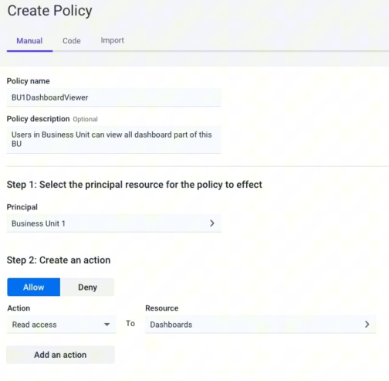
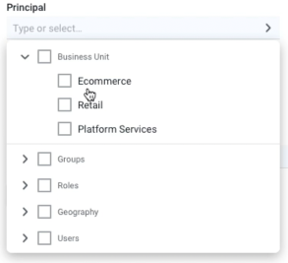
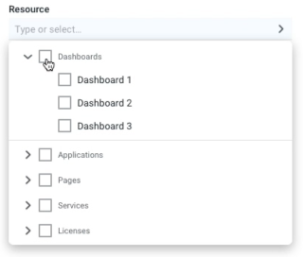
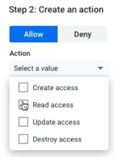
Design
Assumptions
Manage via API, or import from rules from other applications
Entity-based access model, tagging for categorization, and simplified permission inheritance.
Granular access
Simple access controls
Notes:
Assumptions
Admins can manage access for roles, groups, users, and any entity or resource with less effort
Any time an administrator onboards a new application, creates a dashboard, or adds a user into the system, they can create permissions allowing or denying access
Admins can further refine access as needed
This model of access would go beyond confusing role based access control, and allow users to assign permissions more intuitively.

Slide 10

Validation
01
User Research & Competitive Analysis
02
Prototype Development
03
Iterative Testing
Notes:
User Research & Competitive Analysis: Conducted interviews with IT admins and analyzed access management models (like AWS policies) to inform our approach. Discovered that admins favored a “least-privilege” model.
Prototype Development: Created high-fidelity wireframes and interactive prototypes based on an entity-level policy model that allowed permissions to be set for roles, groups, and individual users.
Iterative Testing: Conducted usability testing to validate the design, simplify complex processes, and refine features like role creation, tagging, and policy assignment.
Collaboration with Engineering: Worked closely with the engineering team during agile sprints to ensure smooth hand-off and a seamless user experience across platforms.
I’d rather have one simple menu that stays the same and use it that. On 1 out of 10 for importance of a simple interface, I’d say it’s an 8.
Must go through change management to add new groups
There are “one-off” access requests, but usually handle them case by case
Want to keep things simple

Slide 11
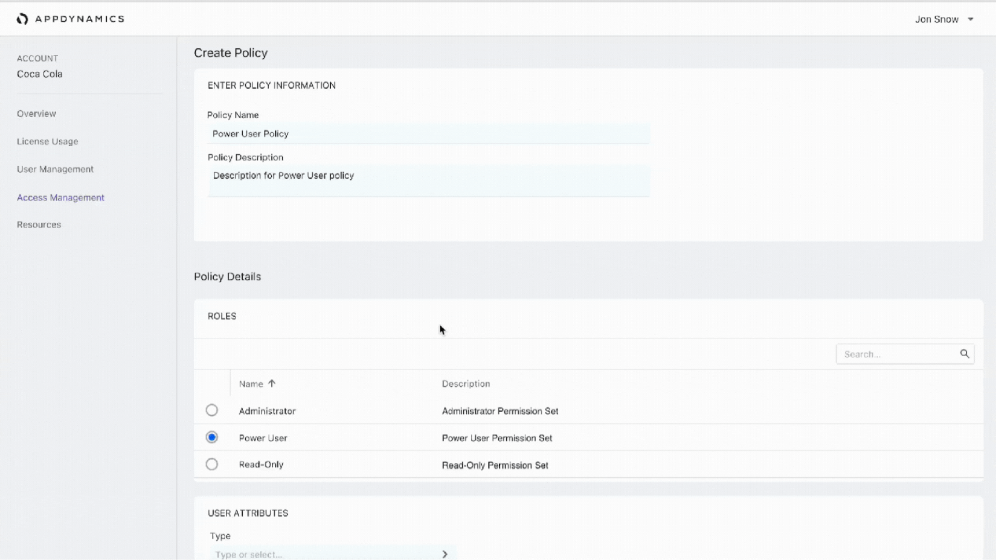
Notes:
Key Features: Entity-based access model, tagging for categorization, and simplified role creation.
Process: Comparative analysis of other systems (e.g., AWS policies) to inform an industry-standard access structure.
Testing: Conducted usability studies and card sorting with IT admins to refine terminology and clarify permissions.
Research & Discoveries: User interviews and competitive analysis, helped validate the need for scalable, granular permissions.
Iterations & Tradeoffs: Testing brought the insight to incorporate tagging and entity-level controls
We pulled it out of the controller monolith and into it's own microservice within the admin/accounts experience to address scale

Slide 12

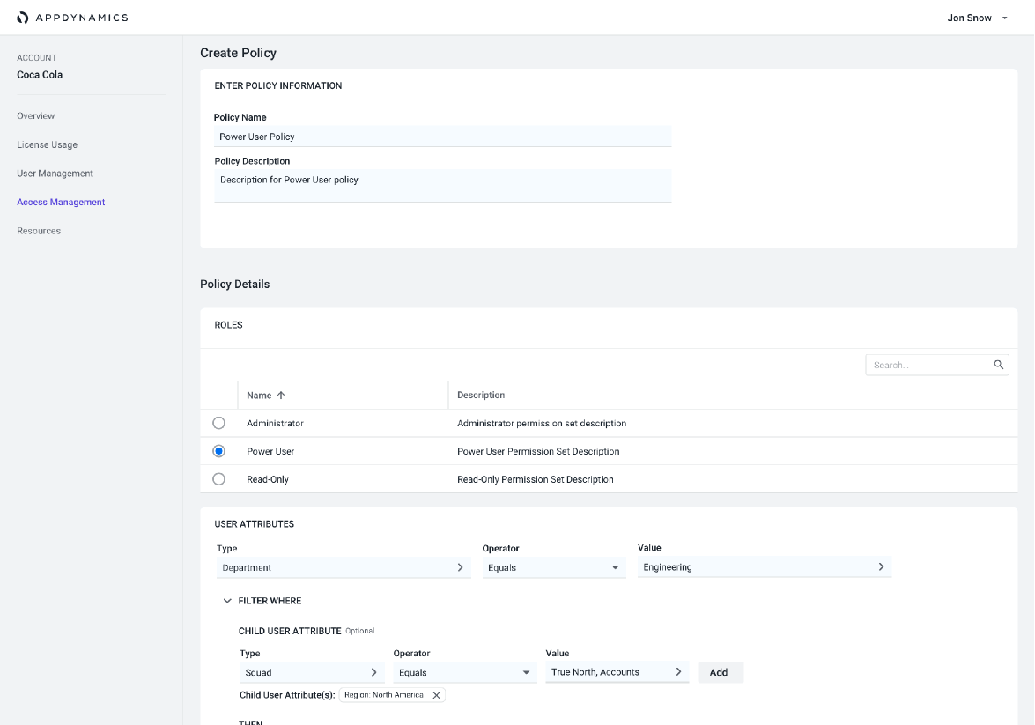
Designing for Scale
https://www.appdynamics.com
Notes:
Admins want simplicity
“As a sysadmin I go into these tools to do config, and there are definitely systems I feel lost. There are menu options on the left, on the top [...]. I don’t like diving through all these menus to do simple stuff. I’d rather have one simple menu that stays the same and use it that… ”
“We like products that integrate with AD. Instead of being able to import and delete users in one place we had to go through a checklist of things in each application. If this guy gets fired we have to go through a long checklist of actions in different places just to delete them.”
“The more granular the better, everything is least privilege model so you can slowly start adding things they need”
From research to insights
We heard from respondents that they prefer the “least privileged model”, which validated our assumptions that users needed more granular control and would benefit from our policy model.
This led the team to further explore the least access privilege model, and build the policies on top of that.
The principle of least privilege is an information security concept in which a user is given the minimum levels of access or permissions needed to perform their job functions.

Slide 13
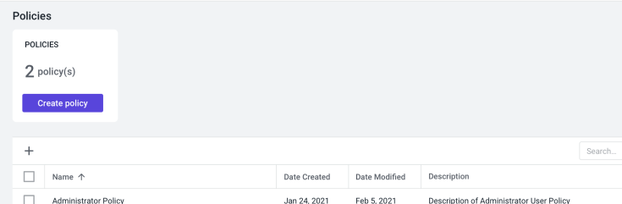
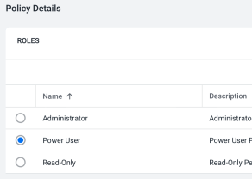
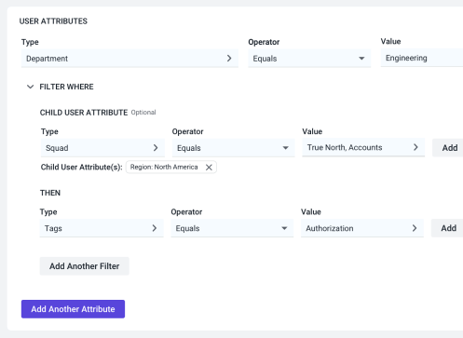
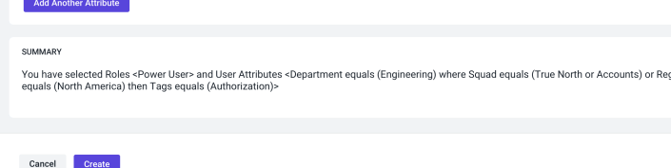
Results
Reduced Setup Time: Admins could now manage permissions faster, leading to a more efficient and user-friendly experience.
Improved Security and Usability: The new model allowed for granular, least-privileged access control, reducing security risks and creating a more flexible permissions structure.
Customer Satisfaction: Positive feedback from usability testing and client responses post-launch indicated increased satisfaction and a stronger sense of control for admins.
Notes:
Reduced 16 step minimum access management sequence across multiple controller instances, all with unique logins, to a single 5 step minimum global interface. This also preserved compatibility with legacy systems.
After hearing how users think about setting access control, we committed to the least privileged access model.
We improved security by ensuring users wouldn’t get access where they didn’t need it while providing clarity.
We build a foundation for global access policies at the entity level

Slide 14

Learnings
Reinforced the importance of validating design with end-users.
Designing scalable systems that meet both user needs and business goals.
What Worked Well: Entity-level access control and tagging; significantly reduced role setup time.
Notes:
This project reinforced the importance of user-driven design choices and cross-functional collaboration in achieving business goals.
Reinforced the importance of validating design with end-users to ensure we’re solving real problems, not just building features. This led to insights like least privilege access model, and the need for a summary section
Gained deeper insight into designing scalable systems that meet both user needs and business goals.
Developed a stronger collaboration model with Engineering, ensuring smoother implementation and better alignment across the team.
What Worked Well: Entity-level access control and tagging; significantly reduced role setup time.
What Worked Well: Entity-level access control and tagging; significantly reduced role setup time.
The concepts I learned from least privilege access model, permission architecture I refined and used as the basis for the work I did at One Medical designing experiences for multiple roles to facilitate patient care

